Slide 1

RUNGTA COLLEGE OF DENTAL SCIENCES AND RESEARCH
GOOD MORNING
DEPARTMENT OF PROSTHODONTICS
PRESENTED BY RUCHA KASHYAP

Slide 2
INDICATIONS, CONTRAINDICATIONS
and
CLASSIFICATION OF BRIDGES

Slide 3
CONTENTS
· Introduction
· General terminology
· General considerations in bridge work
· Indications and contraindications of bridge
· Deciding factors for the success of FPD
· Classification of bridges
· Fixed-fixed bridge
· Fixed – movable bridge
· Cantilever bridge
· Spring cantilever bridge
· Compound bridge
· Fiber-reinforced composite fixed prosthesis
Andrew's Bridge System
· Minimal preparation bridge
· Implant supported FPD
· Conclusion
· Reference

Slide 4
SPECIFIC LEARNING OBJECTIVES
SR.NO | CORE AREA | DOMAIN | CATEGORY
1. | INTRODUCTION CLASSIFICATION | Cognitive | Must Know
2. | ADVANTAGE/ DIS ADVANTAGE INDIACATION/ CONTRAINDICATION SELECTION OF ABUTMENT TEETH TYPES OF ATTCHMENTS | Cognitive | Must Know
3. | SUMMARY | Affirmative | Must Know

Slide 5
INTRODUCTION

Slide 6
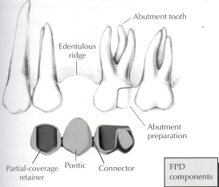
GENERAL TERMINOLOGY :
Fixed partial denture(bridge): That is luted or otherwise securely retained to natural teeth, tooth roots and / or dental implant abutments that furnishes the primary support for the prosthesis.
(According to GPT – 8)
Fixed Prosthodontics : The Branch of prosthodontics concerned with replacement and /or restoration of teeth by artificial substitute that are not readily removed from the mouth.
Synonyms :
Fixed prosthesis
Fixed – fixed bridge
Fixed bridge or fixed appliance ( UK)
Fixed partial denture (USA)

Slide 7
GENERAL CONSIDERATIONS IN BRIDGE WORK :
Patient attitude :
Different degrees of enthusiasm for fixed and removable prostheses
Procedure
Full cooperation
Oral hygiene :
Poor oral hygiene recurrent caries
Systemic disease :
sudden bouts of unconsciousness, or fits,
removable appliance
fixed prosthesis - increased liability to trauma
adequate strength and retention

Slide 8
Occupation :
Sports players, wind-instrument’s players
Public speakers and singers - the confidence that
comes from wearing a bridge.
Orthodontic considerations :
Classical example – replacement of lateral incisor after midline diaestmaes closure.
Young –space maintainer

Slide 9
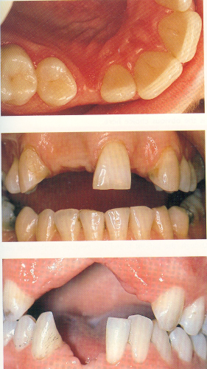
Periodontal reasons
Fixed splint /fixed-fixed bridge
Prevent drifting
Long term prognosis
Forces of mastication
Avoids over-eruption
Speech : correction of speech defect
bulk of RPD
Function & stability :
psychological benefit
Forces –> periodontium –> alv bone –> jaw bone
Local indications
Teeth suitable for abutment which require restn.
Lack of space for suitable replacement
- By reducing the size / altering the shape of crown
Tilted teeth- does not fill proximal undercuts
food impaction.

Slide 10
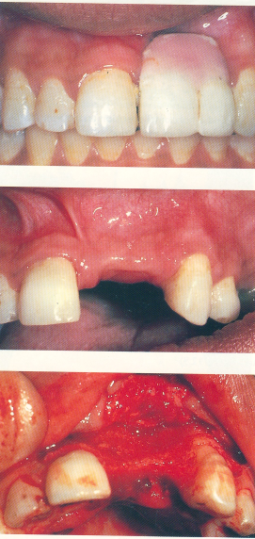
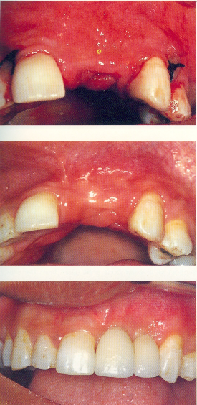
Significant alv bone loss ridge augmentation& minimum preparation bridge

Slide 11
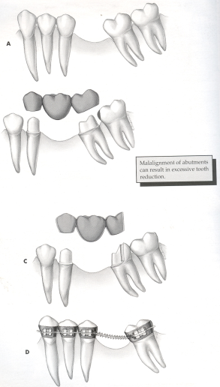
Unfavourable angulation of teeth

Slide 12
Contraindications to bridge prosthesis :
GENERAL FACTORS :
Inability of patient to cooperate :
psychological and medical
Age of patient :
the young or the very old
Length of clinical crown :
younger patient
chamfer rather than a feather finishing margin
main cause of the high failure rate (< 21 years)
Caries rate :
highest(< 21), falls by 35
the high failure rate

Slide 13
GINGIVAL AND PERIODONTAL CONSIDERATIONS :
Gingival hyperplasia : proliferation of the gingival tissues around the bridge
Severe marginal gingivitis :
Any prosthesis is liable to increase plaque formation aggravate any gingivitis
the finishing margins at least 1- 1.5 mm clear
Advanced periodontal disease :
prognosis of the remaining teeth is obviously poor

Slide 14
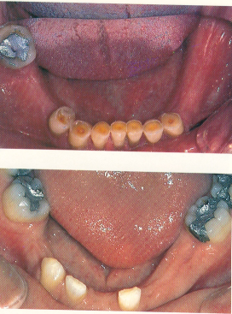
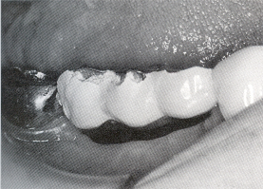
Local factors contraindicating a bridge
Prognosis of Abutment Teeth
Malformed dentin
Extent and position of caries
Deep sub-gingival caries
Periapical infection
Effective root surface
Periodontal condition
Longer span - Ante’s law
Possibility of further loss in same arch
Ridge form and tissue loss
Removable precision retained prosthesis
Unfavourable tilting rotation of the teeth

Slide 15
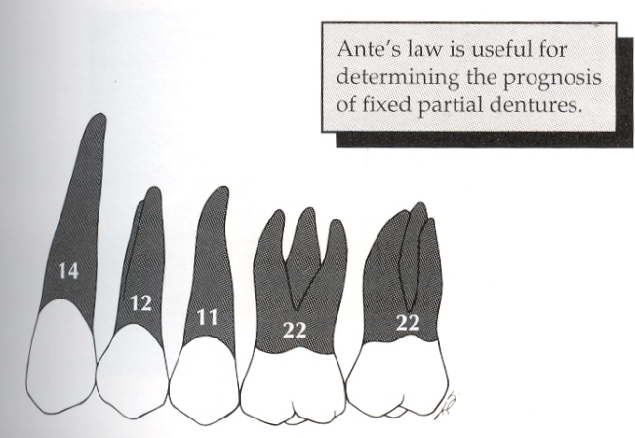
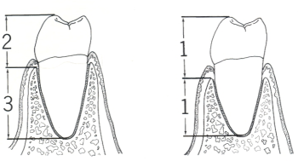
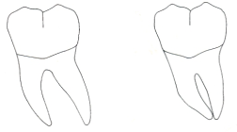
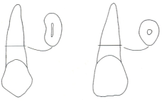
DECIDING FACTORS FOR THE SUCCESS OF FPD TREATMENT
Two important factors
- Support (abutment teeth considerations)
- Occlusal forces (Biomechanical
considerations)
ABUTMENT TEETH CONSIDERATIONS
Supporting tissues.
Crown root ratio
Root configuration

Slide 16
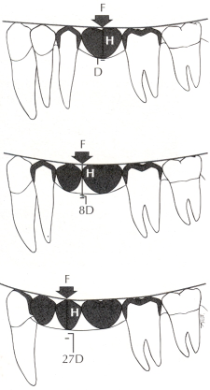
Biomechanical considerations
Long span bridges : increased load on the periodontal ligament
Bending or deflection varies directly with the cube of the length and inversely with the cube of the occlusogingival thickness of the pontic.
more toruquing forces on the abutment.
pontic designs with a greater occlusogingival dimension
an alloy - nickel-chromium
Preparation modification

Slide 17
Double abutments : unfavourable crown-root ratios
long spans
secondary abutment
Arch curvature :
pontics - outside the interabutment axis line
torquing movement
first premolars (secondary abutments) - a maxillary
four-pontic canines-to-canine fixed partial denture

Slide 18
CLASSIFICATION OF BRIDGES
1. Depending upon location - Anterior bridges
- Posterior bridges
2. Depending on number of teeth - 2 Unit bridges
- 3 Unit bridges
3. Depending upon the tooth reduction
- Conventional preparation bridge
- Minimal preparation bridge
4. Depending on support
- Tooth supported FPD : - Conventional or rigid FPD
- Cantilever FPD
- Resin bonded FPD : - Conventional
- Fibre reinforced

Slide 19
Implant supported FPD : - Screw retained FPD
- Cement retained FPD
5. Depending on material used: - Cast metal FPD
- All ceramic FPD
- Metal ceramic FPD
- Resin veneered FPD
6. Depending upon construction : - Cast metal FPD
- CAD CAM assisted FPD
- Direct fibre reinforced RBFPD
7. Depending upon the connector :
- Fixed – fixed bridges – Anterior, posterior
- Fixed – fixed movable bridges – anterior, posterior
- Springs cantilever bridges
- Cantilever bridges
- Compound bridges

Slide 20
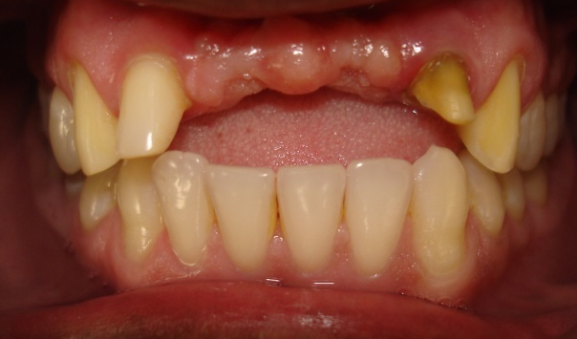
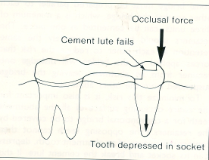
Fixed – fixed bridge :
rigid connector at both ends of the pontic.
prepared parallel to each other
cemented in one piece.
Stress imposed evenly b/w abutments.
the entire occluding surface - covered by the retainers.
More stress on chemical bond than in a fixed-movable design.
no independent natural movement
extreme caution when deciding on
a suitable retainer
Caries is extremely rapid
longer the span the greater the stress
on the solder joint .

Slide 21
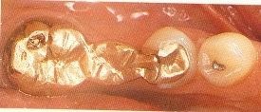
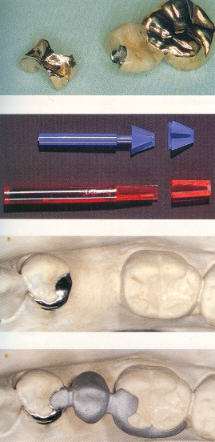
Fixed – movable bridge :
major retainer
minor retainer
resist both separation of the pontic from the retainer and lateral movement of the pontic
Occlusal forces - tooth surface not covered by the retainer - depress the tooth- movement at the movable joint rather than rupturing of the cement lute. – degree of stress breaking.
more successful than fixed-fixed ( the risk of debonding is reduced)
Retainers :
The three-quarter crown, MO, DO, or MOD inlay

Slide 22
Fixed-Semi movable bridge
Posterior moderately long span bridge
Movement restricted
Sufficient to break the stress
Cement failure
Same line of insertion
Precision Retainers
Frictional fit
Equal retention from both retainers
Housing the retainer – Deeper box/ slot/ keyway
Large well erupted tooth

Slide 23
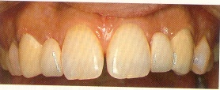
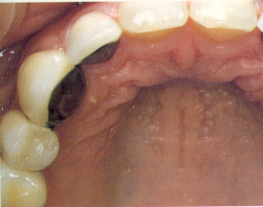
Cantilever bridge :
support for the pontic at one end only.
either mesial or distal to the span,
Cantilever bridges
- less destructive and good record of
success.
- Simplicity in designing
- Excellent esthetics.
Indication: Contraindic:
lateral – 1 abutment Canine replacement
premolar – 2 abut Molar pontic
Tramatic occlusion
Deep bite

Slide 24
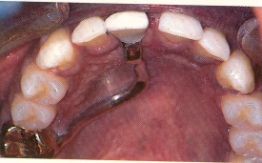
Spring cantilever bridge :
Tooth retained & tissue borne pontic
the replacement of upper incisor teeth.
Flexible palatal bar
Forces are absorbed by the springiness of the arm and by displacement of the mucoperiosteum of the palate
replaced either by minimal-preparation bridges
to preserve intact anterior teeth (natural esthetics), unsuitable anterior teeth as abutments, when posterior teeth needed crowning
to preserve diastemas
Contraindications:
- Unusual shape of palate
- Soft tissue loss (vertical defect of bone)

Slide 25
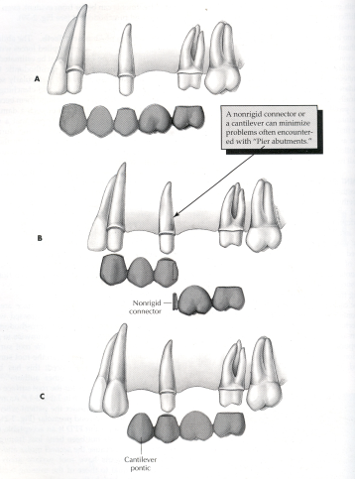
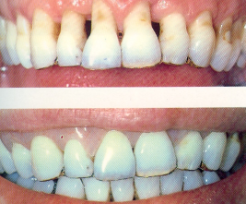
Compound bridges :
the fixed-fixed and cantilever designs
fixed-fixed and fixed-movable designs.
a bridge with a removable buccal flange that replaces lost
alveolar tissue.
Compound bridge

Slide 26
Advantages :
simplifies the construction of the prosthesis :
complex bridge to be broken down into several
the unfavourable angulation of the abutment
same line of insertion and withdrawal
- simplify preparations and conserve tooth tissues-
lighter preparations
Precision retainers - permit the separation of two or more components
repair

Slide 27
Comparison of Conventional Bridge Design
Advantages
Fixed-fixed
Robust design
Splinting effect
Larger bridge
Construction
Fixed-movable
Divergent abutment
Independent retention
More conservative
Minor movements
Cementation
Disadvantages
Parallel preparation
Over reduction
Cementation
Limited span
Complicated construction
Temporary bridge

Slide 28
Cantilever
More conservative
Simple Construction
Suitable for anteriors
Limited to one pontic
Construction must be rigid
Posteriors – tilting of abutment

Slide 29
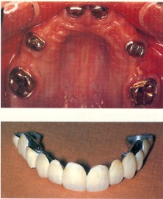
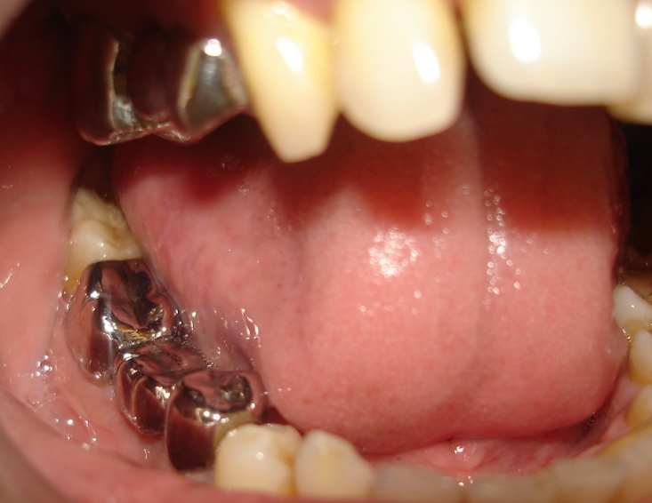
Removable bridges :
permanent cementation of large bridges
the maintenance and further endodontic or
periodontal treatment of abutment teeth is difficult
can be removed by the patient.
cleaning around the abutment teeth
The bridge has to withstand handling
acrylic facings
Long success - doubtful
All metal bridge :
both conventional and minima-preparation
Esthetics not prime choice
The margins are easier to adapt to the
preparations

Slide 30
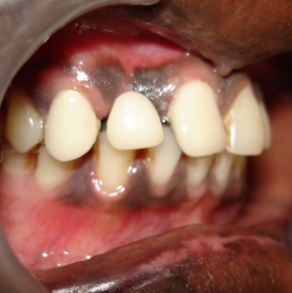
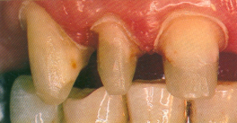

Metal ceramic bridge :
When the strength of metal is required together with a tooth-coloured retainer or pontic, metal – ceramic is the best material
All – ceramic bridge :
limited to two-unit cantilever bridges or three-unit fixed-fixed bridges.
conventional feldspathic porcelain --> satisfactory appearance
The newer cast-ceramic and reinforced porcelain materials

Slide 31
Combinations of materials :
A metal – ceramic retainer and pontic with a movable connector to a gold inlay or other minor retainer.
An all – metal retainer (a full or partial crown) towards the posterior end of the bridge with anterior metal-ceramic units.
Fiber reinforced composite fixed prosthesis :
an innovative alternative
a conservative approach
overcome drawbacks of conventional prostheses.
a fiber-reinforced composite (FRC) substructure veneered with a particulate composite material.
exhibits better physical properties and esthetics than direct placement composite restoratives

Slide 32
Indications :
1. The need for a restoration with excellent appearance.
2. The need to decrease wear of the opposing dentition.
3. The use of conservative intracoronal abutment tooth
preparations.
4. The potential for bonding the prosthesis retainer to the
abutment.
5. The desire for a metal–free, nonoporcelain prosthesis
( especially metal allergies).
Contraindications :
1. Patients with chronic or acute gingival inflammation
2. Long span (i.e., two or more pontics)
3. Parafunctional habits

Slide 33
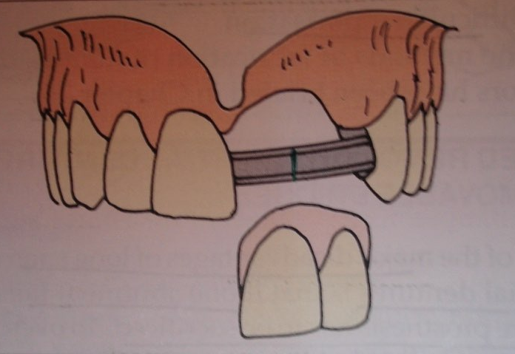
Andrew's Bridge System
Indicated for edentulous ridge with severe vertical deficit.
Prosthesis consists of a fixed component and a removable component.
Fixed component –metal. Consist of two coping( cemented on to the prepared abutment on either side of the edentulous ridge) connected by a load bearing bar.
Removable Component – Artifical teeth and a denture flange to hide the vertical ridge defect. It is designed to fit or clasp the horizontal bar.

Slide 34
MINIMAL PREPARATION BRIDGES
DIRECT
INDIRECT
Macro mechanical retention
eg. Rochette
Medium mechanical retention
eg. Virginia Salt Mesh Crystal bond
Micro mechanical retention – eg. Maryland
Chemically adhesive – eg. panavia.

Slide 35
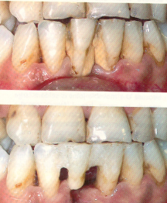
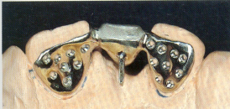
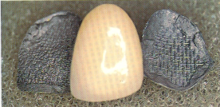
Direct bridges :
the crown of the patient’s own tooth.
simple and rapid way
an acrylic denture tooth can be used
Macro-mechanically retentive bridges :
perforations through the wing like cast-metal plate retainer
holes are cut in the wax
Medium-mechanical retentive systems :
all involve retentive features cast as part
of the metal framework.
thick retainer
Virginia salt technique - 150 -250 micro mm
Cast mesh bridge

Slide 36
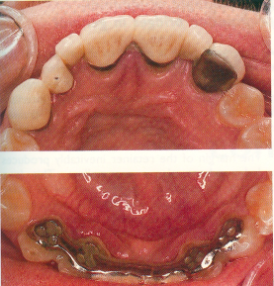

Micro-mechanical retention :
casting the metal retainer
etching : electrolytic etching in acid
chemical etching with a hydrofluoric acid gel
smaller etch pits and unnecessary non-retentive features
thinner metal retainers
Chemically retentive resins :
adhere chemically to recently sandblasted metal surfaces
retained by conventional acid-etching

Slide 37
Advantages of the acid-etch resin bonded fixed prosthesis:
Reduction of tooth structure
Kind to young or large pulps
Maximum esthetics
Pontic and embrasure forms
easy to keep clean
Minimum chair time
less expensive than a conventional
rebonding possible
No permanent damage to the dentine
Individual characterization
No irreversible procedures are involved
Disadvantages of the acid-etch resin bonded fixed prosthesis
1. Uncertain longevity
2. The added thickness of the retainers.
3. The composite in the countersunk areas may abrade
4. The unfilled resin, a polymer, absorbs water molecules, and fluids
5. No space correction :.
6. No alignment correction :
7. DIfficult temporization :

Slide 38
Indications :
1. missing tooth, adjacent to intact teeth.
2. esthetics is of primary concern.
3. transitional fixed prosthesis
4. Anterior periodontal splinting procedures
5. Lingual ramps on maxillary canines to create
canine disclusion.
Contraindications :
1. Inadequate horizontal overlap
2. Short teeth with inadequate lingual enamel
3. Previous restorations or large areas of caries
4. Heavy anterior occlusion in excursive movement
5. Deep vertical overlap
6. nickel sensitivity
7. Significant pontic width discrepancy
8. Long edentulous span.

Slide 39
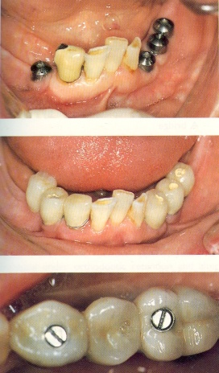
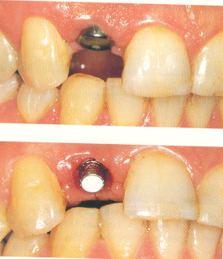
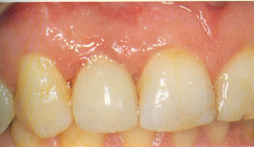
IMPLANT SUPPORTED FPD
MOST ADVANCED & DEMANDING
ADVANTAGES
Retreivability
Independence from natural teeth
Bone stability
DISADVANTAGES
Risk of screw loosening/ fracture
Need for 2 surgeries
Length of treatment time

Slide 40
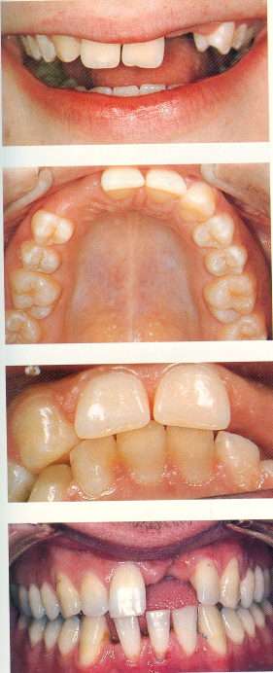
Indications
Unfavourable attitude toward RPD
Long span FPD questionable
Unfavourable no & location natural abutment
Single tooth restoration
Broad & flat ridge-dense bone
Dry mouth
Contraindications
Inadequate bone – site
Poor quality of bone
Medical
Lack of experience
Smoking
Terminal illness
Radiation

Slide 41
Summary
 | RPD | FPD | Resin-bonded | Implant-supported
Span length | Long > 4 Canine + 2 | < = 2 < = 4 | 1 or 2 | Single 2 to 6
Span Configuration | No distal abut Multiple/ bilateral | Distal abut | Mesial and Distal abutment | No distal abut
Abutment Alignment | Tipped Widely divergent | < 25 degrees | < 15 degrees MD Same FL plane | -
Abutment Condition | Short Insufficient | Good Non-vital – can be | Defect free | Defect free
Occlusion | Most adaptable | Favorable loading | Deep bite | Vertical loading
Periodontal condition | Secondary abutment | Bone support 1:1 | No mobility | Dense bone
Ridge form | Gross tissue loss | Moderate Soft tissue defect | Moderate Soft tissue defect | Broad & Flat
 |  |  |  | Dry mouth

Slide 42
conclusion

Slide 43
The replacement of missing teeth in prosthetic dentistry in partially edentulous patient is the most common clinical condition. One of the main consideration for replacement of missing teeth is that the patient are more demanding of fixed prosthesis than removable partial prosthesis.
But fixed prosthodontics is not only answer for every partially edentulous patient, although patient may be quite insistent upon having all of their restorations fixed. It is often neither possible of practical.

Slide 44
A successful treatment planning is based on proper identification of the patient's needs, but Devan`s dictum of “ preservation of what remains” should never be overlooked, at any cost.

Slide 45
TAKE HOME MESSAGE
The clinicians who familiarize himself with precision attachments will add a new dimensions to his treatment options
Proper maintenance and care by the patient and regular follow up decides on the long term success of the attachment and prosthesis.

Slide 46
REFERENCES
1. Contemporary fixed prosthodontics – 3rd edition.
Stephen F. Rosensteil
2. Fundamentals of fixed prosthodontics – 3rd edition
Herbert T. Shilingburg
3. Tylman’s theory & practice of fixed prosthodontics – 8th edition, 1989 William F. P. Malone, David l. Koth
4. Planning and making crowns and bridges – 3rd edition 1998
Bernard GN Smith
5. Johnson’s modern practice in fixed prosthodontics – 4th edition 1987
Dykema Goodakre, Philips
6. Fixed prosthodontics – Keith e. Thayer
7. Fixed bridge prosthesis – 2nd edition 1980
D.H. Roberts
8. Inlays, crowns and bridges
Colin. R. Cowell

Slide 47
QUESTIONS
DESCRIBE THE METHOD OF CLASSIFYING FIXED BRIDGES.EXPLAIN VRIOUS TYPES OF PONTICS AND THEIR INDICATIONS IN BRIDGES.
NAME VARIOUS TYPE OF BRDGES.DIAGRAMMATICALLY NAME THE PARTS OF BRIDGES.CLASSIFY RETAINERS.
OVATE PONTICS
CONNECTOR IN FPD
PONTICS DESIGN

Slide 48

Thank U

